Slide 1
Diabetes
Kaidon Kennedy

Slide 2
My Background
My highest completion of education was my high school diploma. However I did complete college credits such as math 1040(statistics), Chemistry 1060, US history, and humanities.
I am currently employed at Philco Installations llc. It is a window and door installation company, and I have been doing that for about two and a half years.

Slide 3
Project Background
My dad has had diabetes since I was young, and it is a growing concern in our society.
Obesity and diet are the main factors we hear about that effect Diabetes
For my project I wanted to work with some data and bring some awareness to other factors that may be affecting diabetes besides obesity and diet.
Especially I wanted to see the impact that mental health might have on Diabetes.

Slide 4
Project Introduction
Diabetes is a metabolic disease based off of the failure of the pancreas, which in turn doesn’t produce enough insulin. With the lacking of insulin the body doesn’t regulate blood glucose levels.
There are two types of Diabetes: type 1 and type 2.
Type 1 is genetic and onset early in life and type 2 is based off a persons lifestyle choices.
This is why predicting diabetes can be a bit funky, for type 2 is the one that we can predict off of someone’s lifestyle.

Slide 5
Methods
I found a dataset on diabetes that also has a variable for mental health, which was my main goal.
My dataset contains 22 columns and 70,692 rows
Most my data was categorical with two levels, but I did have to create a new variable for good mental health. The variable was wrangled into 0’s and 1’s, with 0’s representing having 7 days or less of bad mental health in a month. 1’s representing bad mental health (8 days or more of bad mental health).

Slide 6
Methods
In my data the main variables I was curious about working with were physical activity, mental health, fruit and veggie consumption, smoking, and income
Mental and physical health were the variables I wanted to test the effect on diabetes the most.
First off I created a correlation matrix to test if any variables had a really high correlation to one another. This is so no variables would skew the results because they’re very similar.

Slide 7
Results
Does the consumption of at least one fruit a day have an effect on whether someone has diabetes?
For this question I used an independent chi-square test.
Eating fruit once a day does have a significant effect on diabetes with a p-value under 0.05
Eating fruit once a day had a greater impact on diabetes than what was expected with a standardized residual of 6.334

Slide 8
Results
Does eating a vegetable at least once a day have an impact on diabetes?
I used a independent chi-square for this test.
With a p-value less than 0.05 eating vegetables at least once a day does impact diabetes.
The amount of influence it has on diabetes was greater than expected with a standardized residual of 6.851

Slide 9
Results
Does mental health seem to influence diabetes or not?
I used an independent chi-square test as well for this.
The p-value also was of significance, showing that mental health does have an influence on someone having diabetes.
The effect good mental health had on diabetes was greater than expected with a standardized residual of 6.158

Slide 10
Results
How does physical activity influence Diabetes if it does impact them at all.
Using a independent chi-square test to explore this question.
P-value is lower than 0.05 so physical activity does significantly influence Diabetes.
Standardized residual is 16.256 so physical activity had a greater effect on diabetes than expected.

Slide 11
Results
I attempted a logistical regression to see if I could determine whether someone had diabetes based off of good mental health or bad mental health.
However I failed two assumptions, so the regression would not be accurate.

Slide 12
Results
Can we accurately predict whether someone has diabetes with the variables mental health, physical activity, and the consumption of fruits and vegetables at least once a day.
For this I used a random forest with 500 variations
Then I found out which variables had the most importance in predicting diabetes using feature importance.

Slide 13
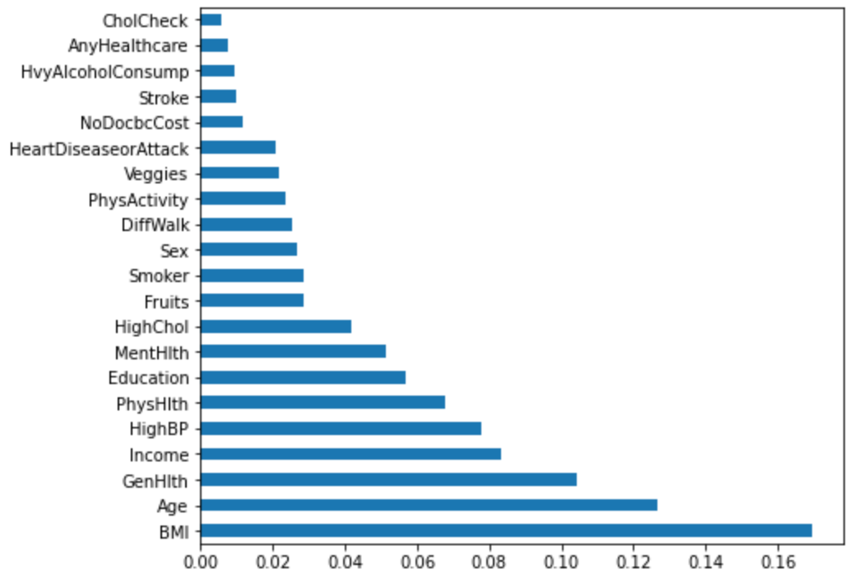
Feature importance graph

Slide 14
Results of the random forest
I compared a random forest with just the five most important variables and with the four variables I wanted to test.
The results were the same with both random forests yielding an overall accuracy of 74%
For medical context 74% is not very good, however it was the best that could be produced.

Slide 15
Summary
Mental health, physical activity, vegetable and fruit consumption of at least once a day all have a greater significant impact on diabetes than to be expected.
With those four variables we can predict diabetes with an overall accuracy of 74%.

Slide 16
Conclusions
My findings bring awareness to diabetes and simple factors that can influence whether or not a person has diabetes. With that being said I want to bring awareness to factors that are easy to achieve, that might affect people’s health.

Slide 17
Questions?

